Slide 1
Transfer Learning
Reporter:張暐杰

Slide 2
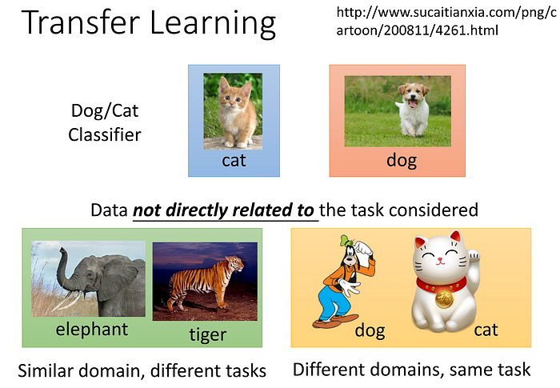
Transfer Learning簡介

Slide 3
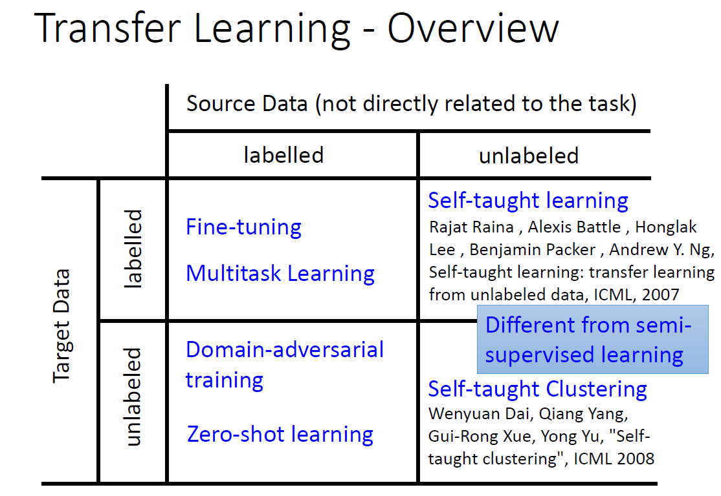
Transfer Learning簡介

Slide 4
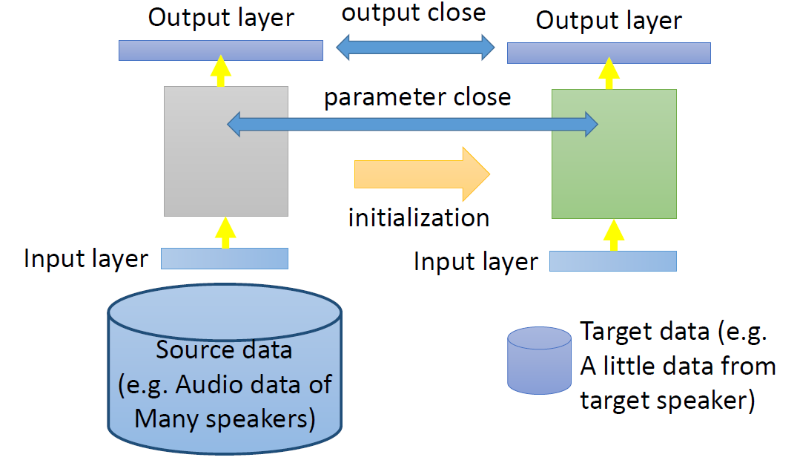
Transfer Learning-Labelled Source Data , Labelled Target Data
Fine-Tuning

Slide 5
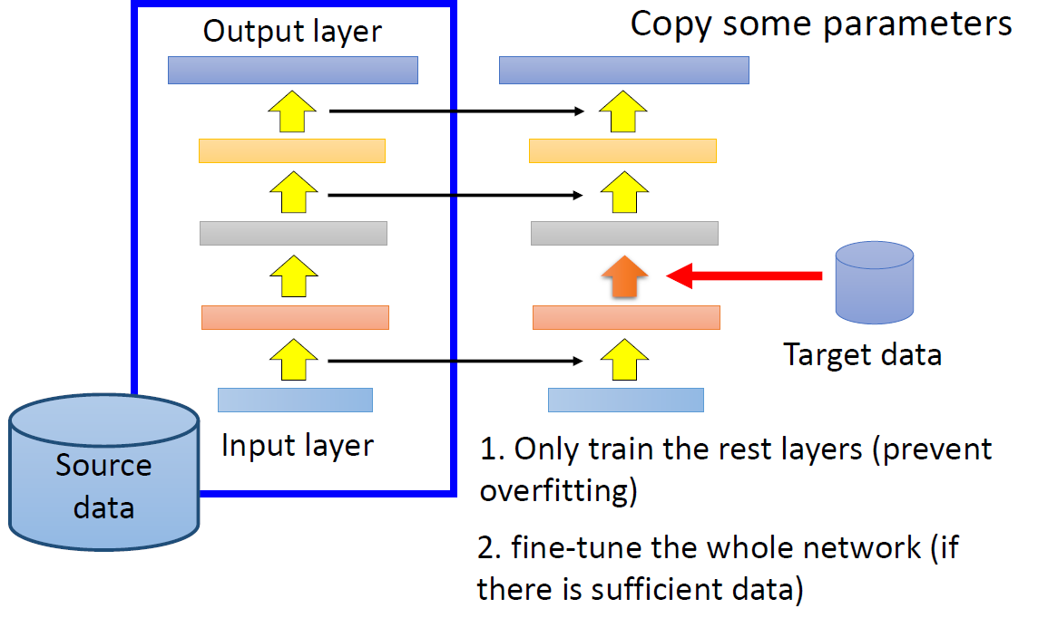
Transfer Learning-Labelled Source Data , Labelled Target Data
Layer Transfer

Slide 6
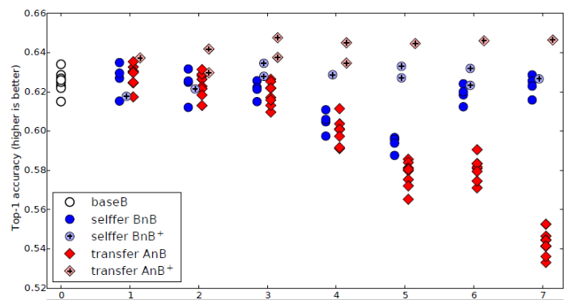
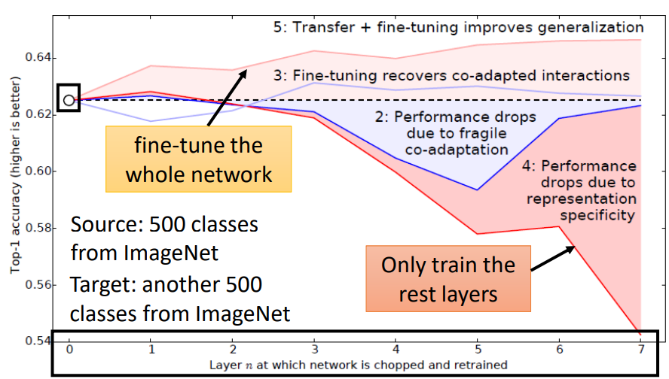
Transfer Learning-Labelled Source Data , Labelled Target Data
Layer Transfer
BnB : Base B 前 n 層 Layer 固定，重新於 Dataset B 訓練後面的 Layer
AnB : Base A 前 n 層 Layer 固定，重新於 Dataset B 訓練後面的 Layer

Slide 7
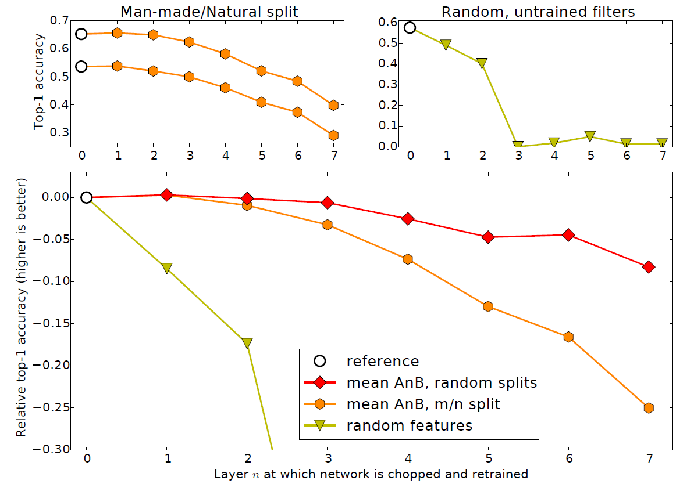
Transfer Learning-Labelled Source Data , Labelled Target Data
Layer Transfer

Slide 8
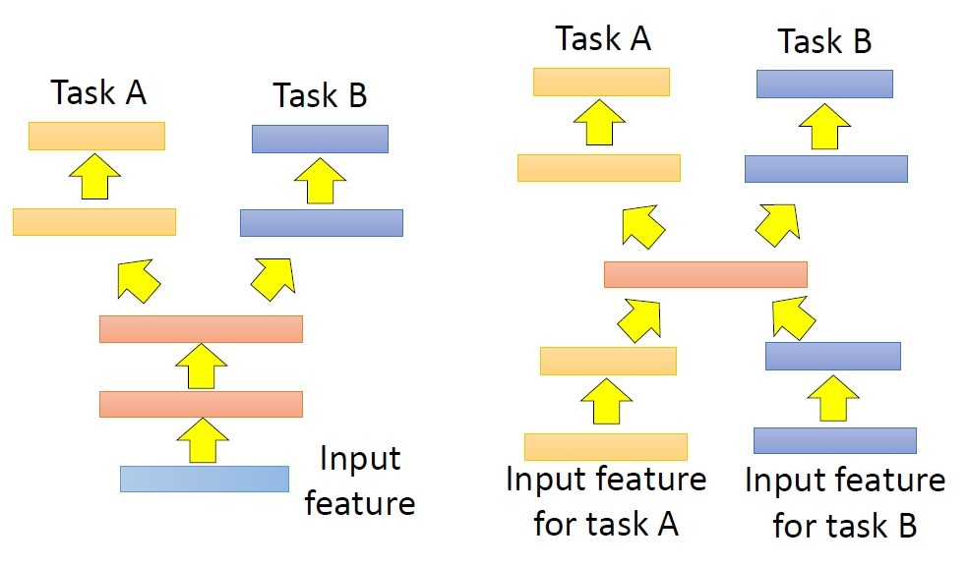
Transfer Learning-Labelled Source Data , Labelled Target Data
Multitask Learning

Slide 9
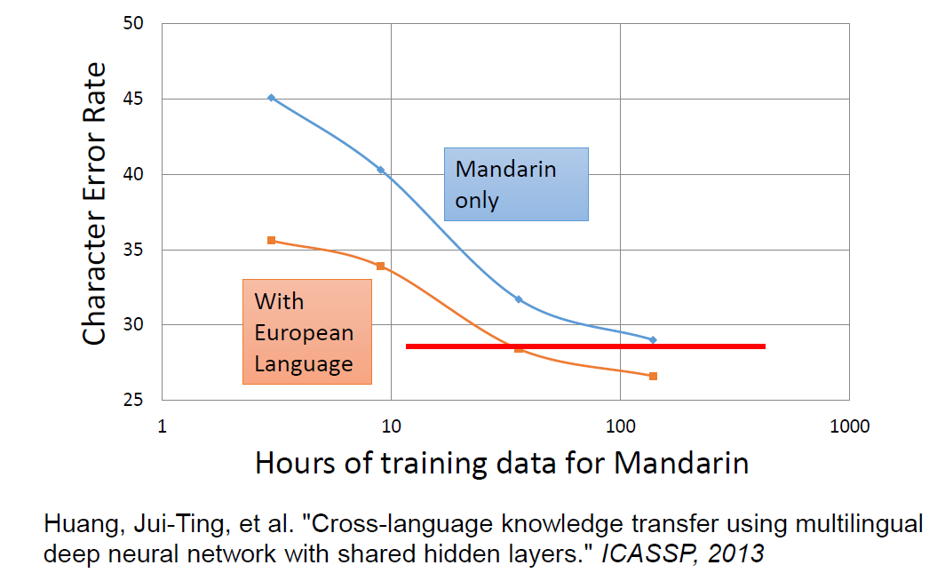
Transfer Learning-Labelled Source Data , Labelled Target Data
Multitask Learning

Slide 10
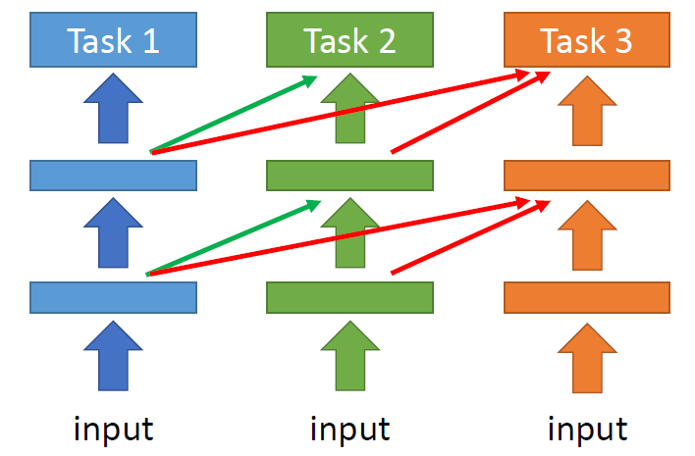
Transfer Learning-Labelled Source Data , Labelled Target Data
Progressive Neural Network

Slide 11
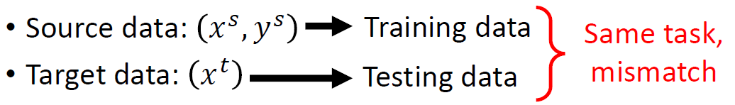
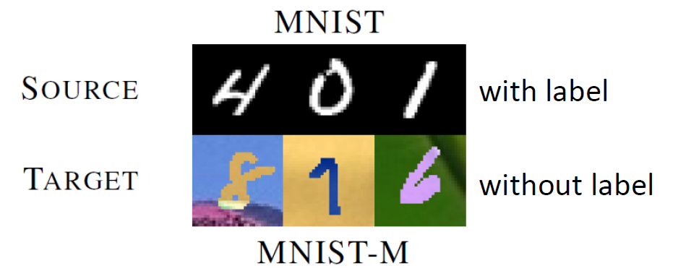
Transfer Learning-Labelled Source Data , Unlabelled Target Data
Domain Adversarial Training

Slide 12
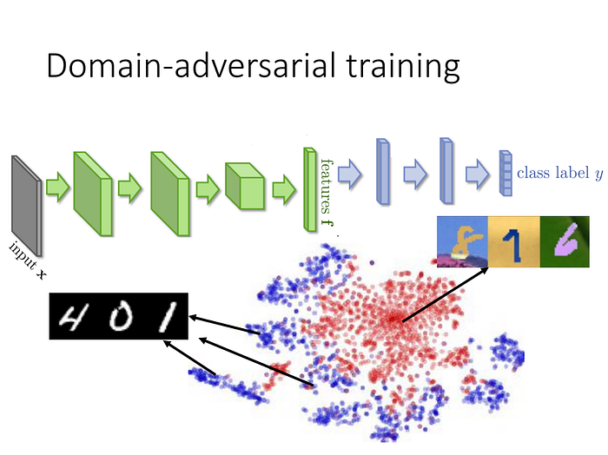
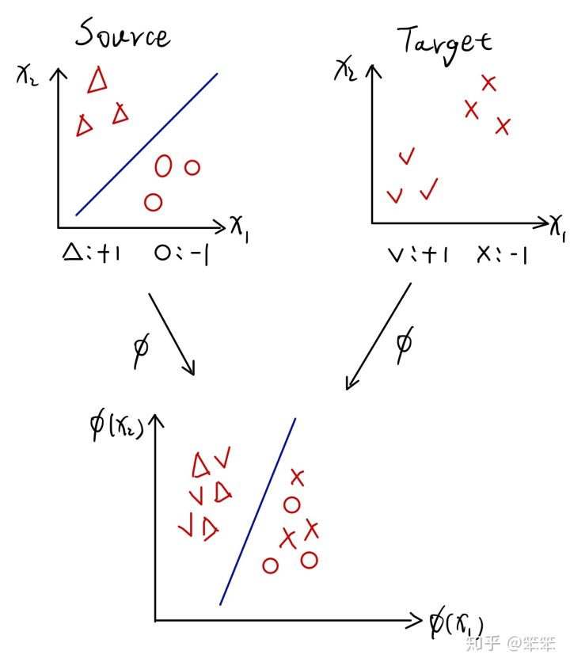
Transfer Learning-Labelled Source Data , Unlabelled Target Data
Domain Adversarial Training

Slide 13
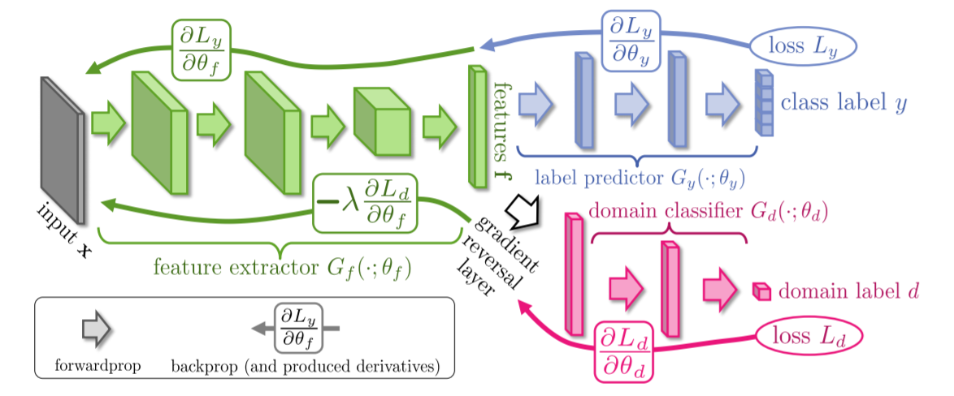
Transfer Learning-Labelled Source Data , Unlabelled Target Data
Domain Adversarial Training

Slide 14
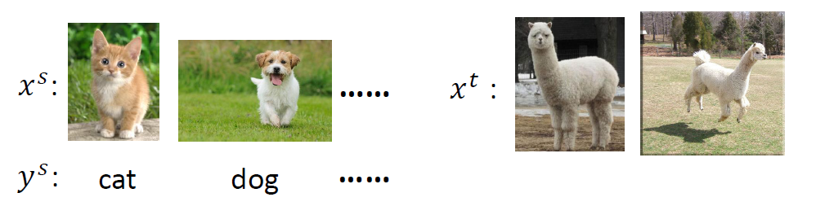
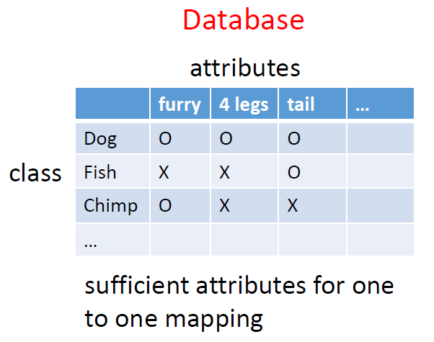
Transfer Learning-Labelled Source Data , Unlabelled Target Data
Zero-Shot Learning

Slide 15
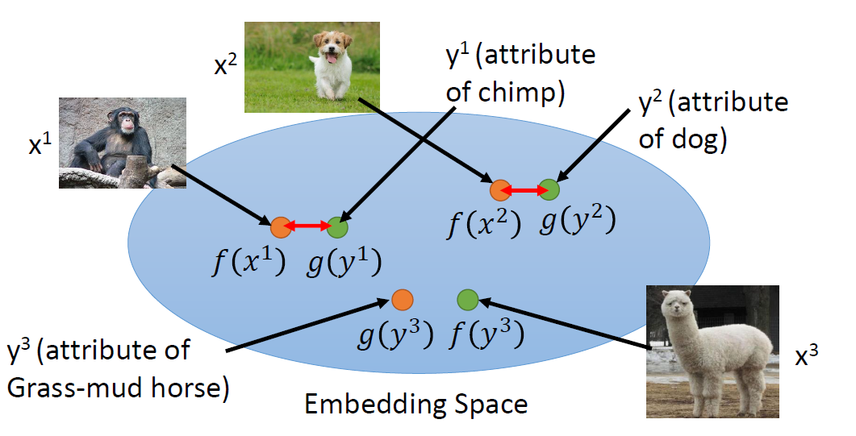
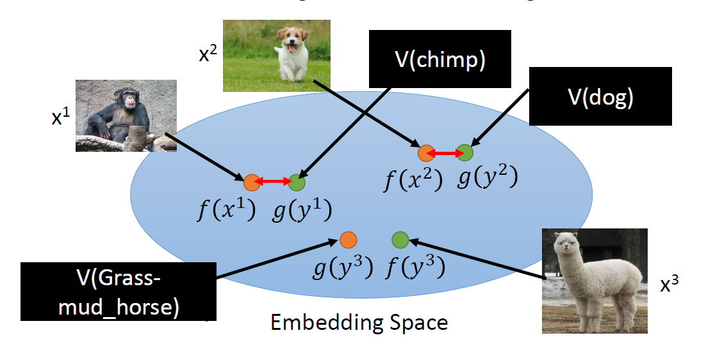
Transfer Learning-Labelled Source Data , Unlabelled Target Data
Zero-Shot Learning
Attribute Embedding
Attribute Embedding + Word Embedding

Slide 16
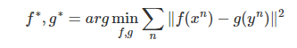
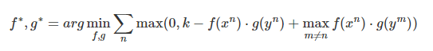
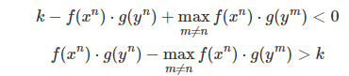
Transfer Learning-Labelled Source Data , Unlabelled Target Data
Zero-Shot Learning

Slide 17
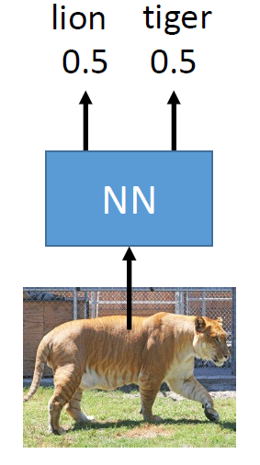
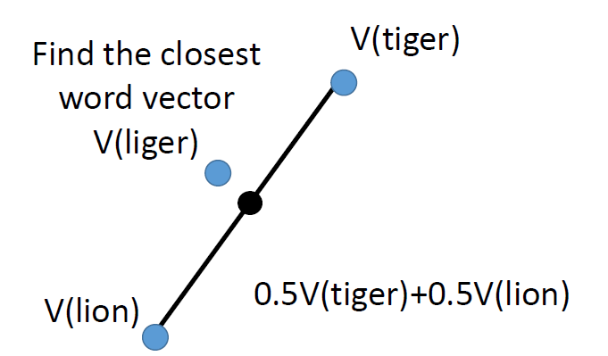
Transfer Learning-Labelled Source Data , Unlabelled Target Data
Convex Combination of Semantic Embedding ( ConSE )

Slide 18
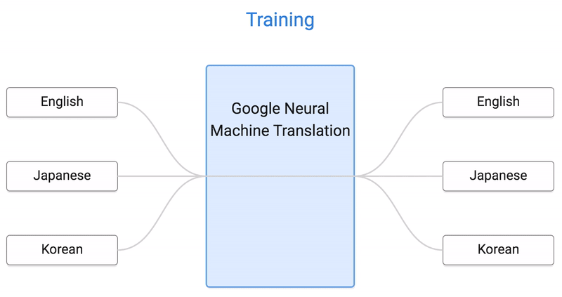
Transfer Learning-Labelled Source Data , Unlabelled Target Data
Zero-Shot Translation

Slide 19
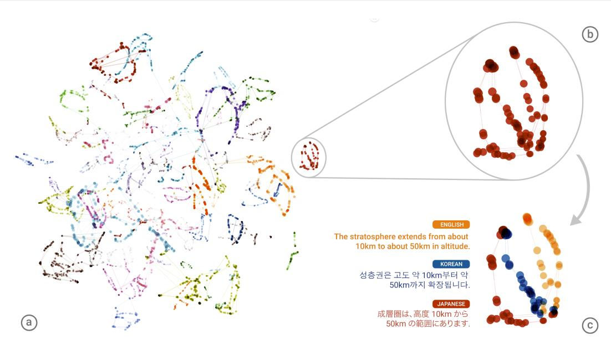
Transfer Learning-Labelled Source Data , Unlabelled Target Data
Zero-Shot Translation

Slide 20
Transfer Learning-Labelled Source Data , Unlabelled Target Data

Slide 21
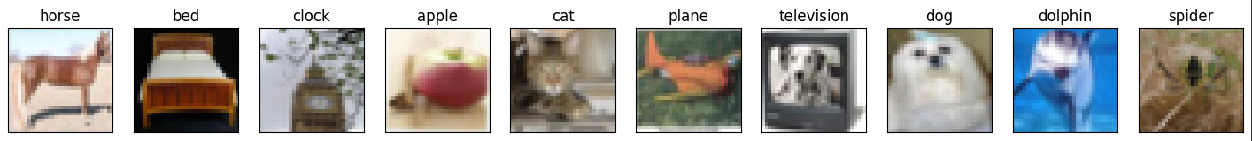
Homework
這次的任務是必須讓model看過真實照片以及標籤，嘗試去預測手畫塗鴉的標籤為何
Dataset:
Training : 5000 張真實圖片 + label, 32 x 32 RGB
Testing : 100000 張手繪圖片，28 x 28 Gray Scale
Label: 總共需要預測 10 個 class，如下圖所示。
Source data
Target data

Slide 22
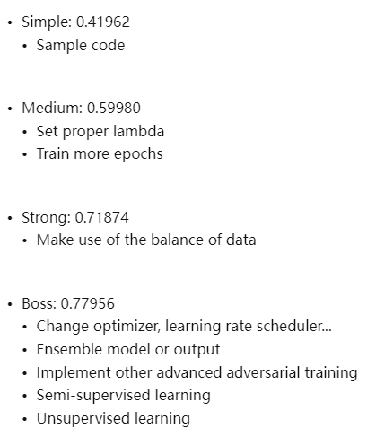
Homework

Slide 23
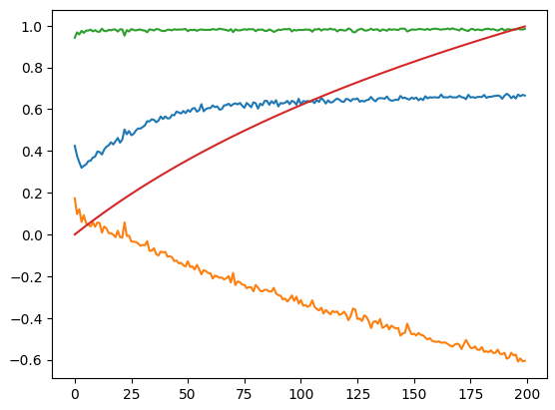
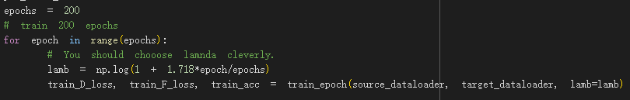
Homework

Slide 24
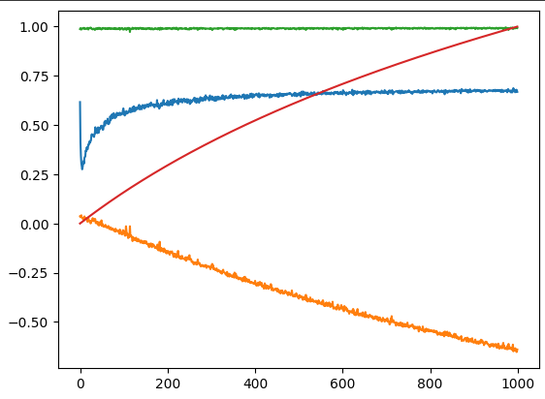
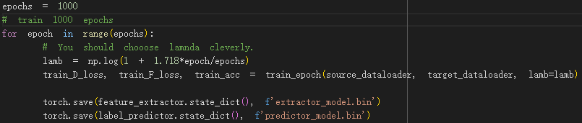
Homework

